Slide 1
LED board rework SOP
2020/08/24

Slide 2
I2C conflicts with AD82584F and LP5036
AD82584F I2C address: 0x31
LP5036 I2C address: 0x30~0x33
Current design is 0x30 and 0x31, so 0x31 of LP5036 needs to change as 0x33 due to easy for rework.
LP5036 is located in 96.1515T00* LED board of 96.1529T00*.
U3_1 and U3_2 are LP5036 and needs to change U3_2 I2C address.
  U3_2: 0x31→0x33, ADDR1=GND→ ADDR1=Vcc3.3.
Currently LED I2C address | LED Driver
0x2A | U3_3(LP5024)
0x30 | U3_1(LP5036)
0x31(conflict) | - U3_2(LP5036) - AD82584F
0x32
0x33
Note *: 96.1515T00: LED board, 96.1529T00: panel of Sub board

Slide 3
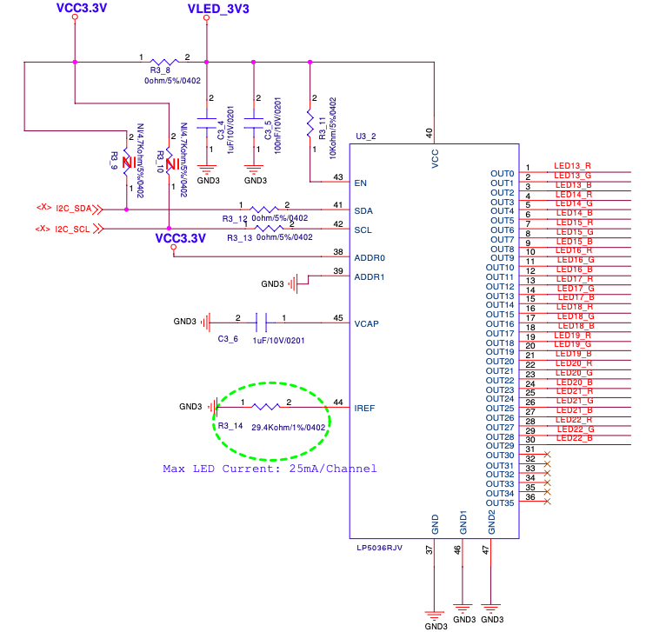
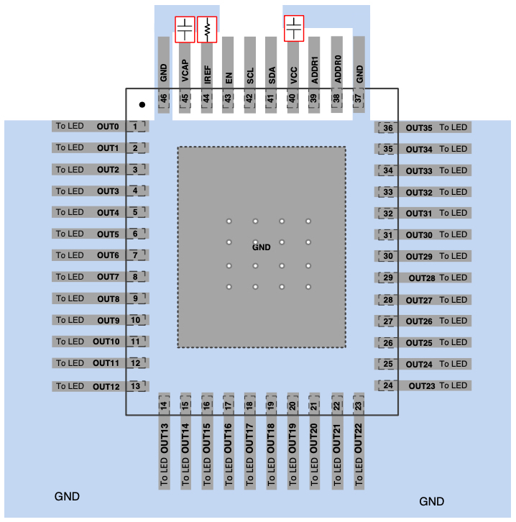
U3_2(LP5036) rework pin
Schematic of LED board: 96.1515T00

Slide 4
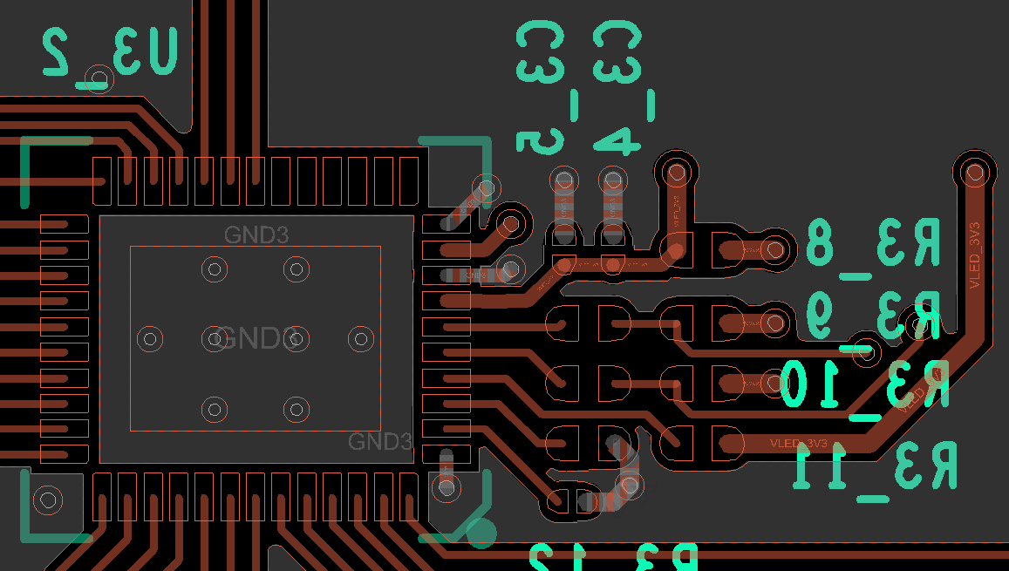
Layout of U3_2
Cut off line
Rework steps:
Cut off GND at Pin 39.
Shorten Pin38 and Pin39 by solder.
Pin38: ADDR0
Pin39: ADDR1
Shorten these 2 pin:
Pin38 and Pin39
U3_2: LP5036

Slide 5
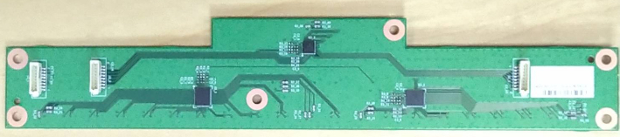
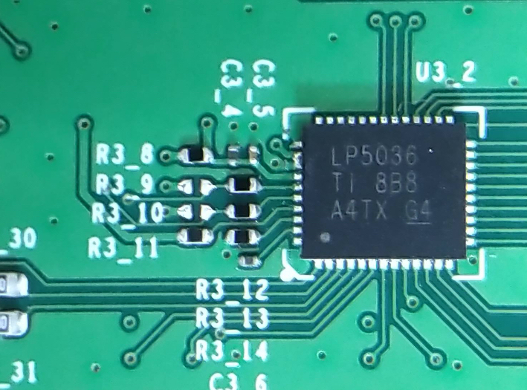
Finished rework
U3_2: LP5036
Pin39
Pin38
1. Cut off net
2. Soldering together

Slide 6
Rework U3_2(LP5036) for I2C address
After rework, the LED driver function is ok for 0x31→0x33 of U3_2(LP5036) verified by SW team.
Need 2 steps to rework
  Cut off net of Pin39
  Solder Pin38 and Pin39 together.
QFN package is small and a little bit difficult to rework.

Slide 7
Audio AMP rework SOP
2020/08/31

Slide 8
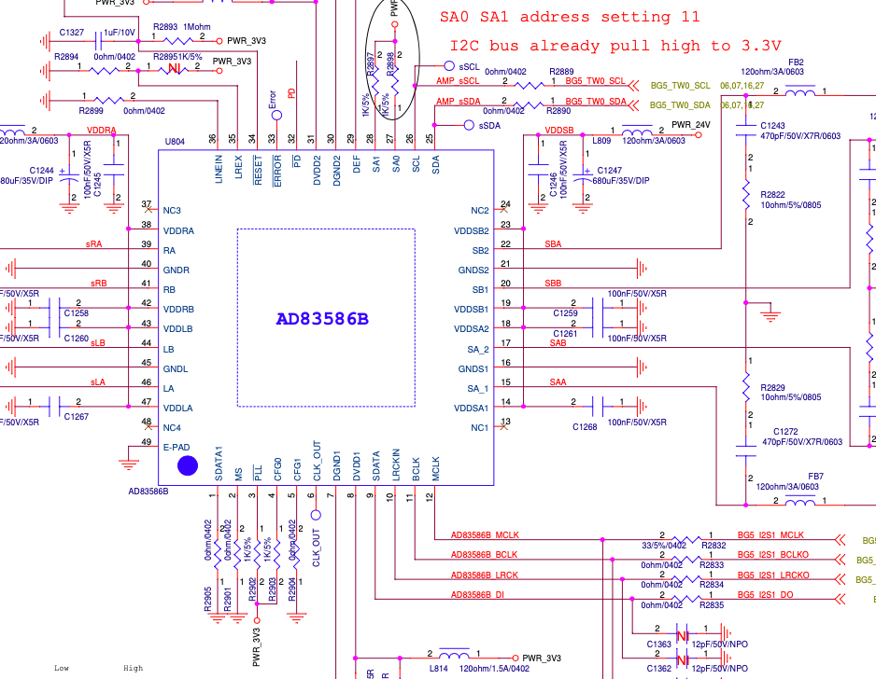
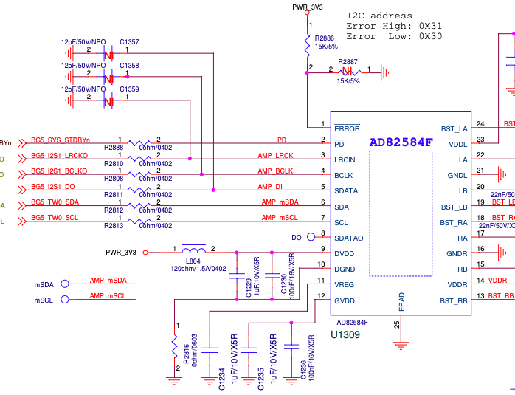
AD83586B & AD83584F-Schematic

Slide 9
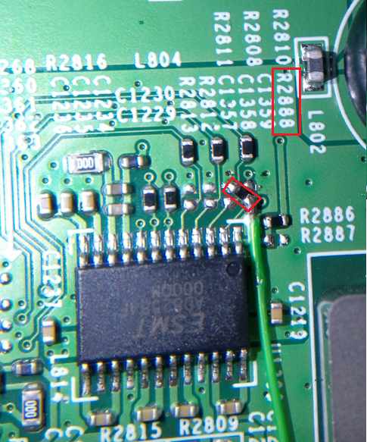
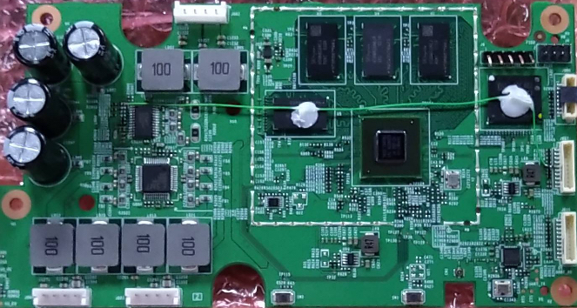
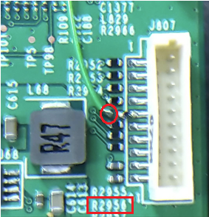
PD pin rework.
PD: Remove R2888 original 0 ohm resistor, and pull 10K ohm to GND.
Pin 1 of R2956
GPIO 32: Use Volume up key to be used for PD pin.
Please remove R2956 first, then connect PD pin to pin 1 of R2956.

Slide 10
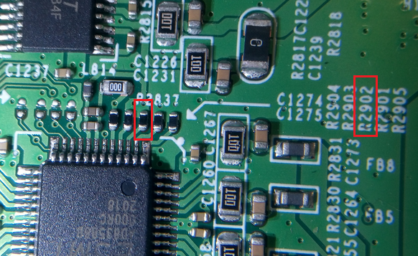
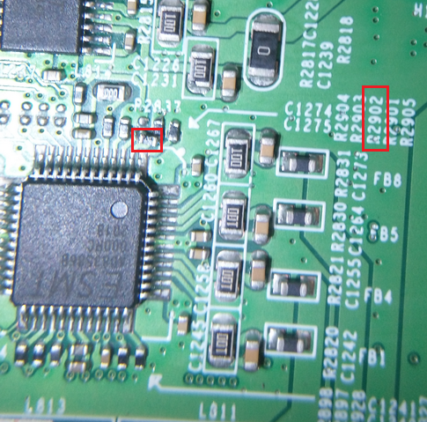
PLL pin rework.
AD83586B’s PLL pin original design, R2902 pull 1K to PWR_3V3.
U804
Please remove R2902 first, then mount this resistor (1Kohm) between pin2 and pin 3 of U804.
PLL pin new design,
R2902 pull 1K to GND.

Slide 11
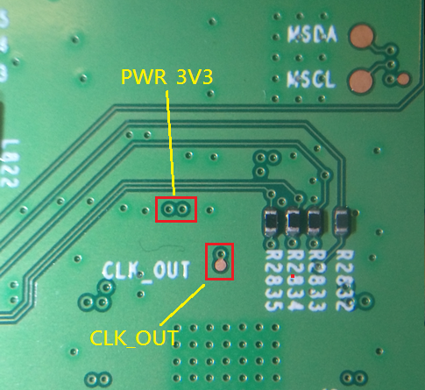
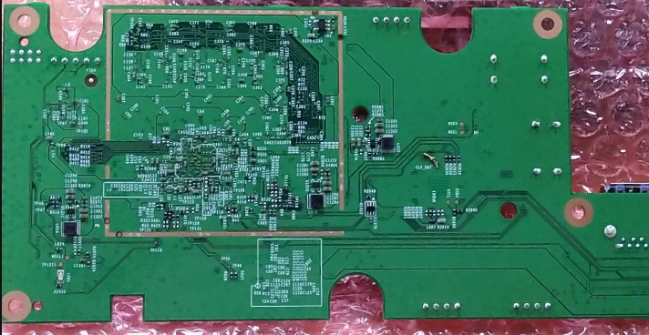
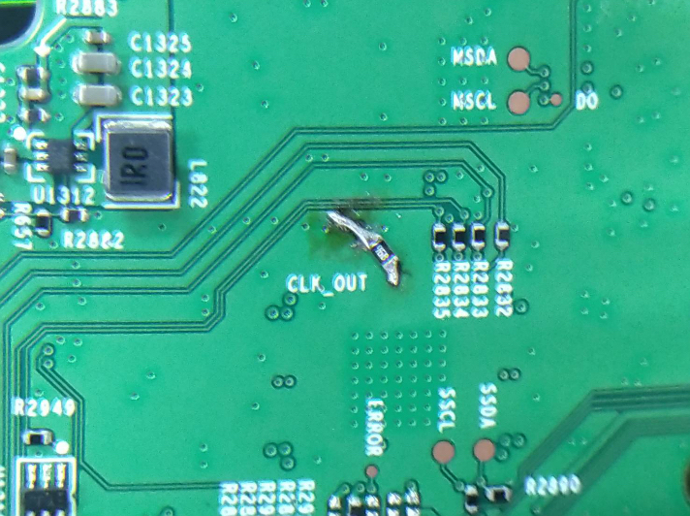
CLK_OUT pin rework.
CLK_OUT: Pull 10Kohm to PWR_3V3.

Slide 12
Rework point of AD83586B/AD83584F audio AMP
1. PIN 3: /PLL
  --> Need to connect a 1K pulled-low RES to GND. This is for using internal PLL. Since the current system MCLK is 24MHz, which can not meet the MCLK frequency requirement of AD83586B.
2. PIN 6: CLK_OUT
  --> Need to connect a 10K pulled-high RES to PWR_3V3, This is to set PLL ratio to one time instead of 4 times to avoid the system MCLK over flow and cause noise issue.
3. PIN 32: /PD
  --> Need to connect it to a normal GPIO instead of always-on SM_GPIO9 (we will rework /PD pin connect to GPIO32, which is used for volume up control in EVT board) , and connected a 10K pulled-low resistor to GND.
  This is used to set the /PD pin remain in low state and ensure that the audio AMP enter to power down mode during the system reboot due to unexpected event.

